Slide 1
Advanced Controls
Programming – Introduction to C#
Last modified 12/12/16 by Alex Mackay

Slide 2
Contents
Multi-Document Interface (MDI) Applications
Copy and Paste
Determining the Active MDI Child
Drag-and-Drop Operations
Integrating User Help

Slide 3
Multi-Document Interface (MDI) Applications
Enables display of multiple documents concurrently
Each document displays in its own window
Often have a Window menu for switching between windows/documents
Notes:
Multiple-document interface (MDI) applications enable you to display multiple documents at the same time, with each document displayed in its own window.
MDI applications often have a Window menu item with submenus for switching between windows or documents.
There are some behaviour differences between MDI forms and single-document interface (SDI) windows in Windows Forms:
The Opacity property does not affect the appearance of MDI child forms.
Additionally, the CenterToParent method does not affect the behaviour of MDI child forms.

Slide 4
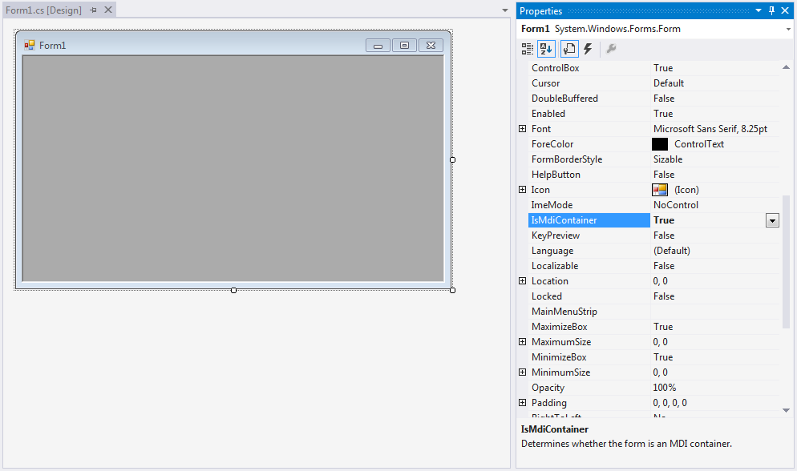
Multi-Document Interface (MDI) Applications
Create a new Windows Form Application
Set the IsMdiContainer property to true
Set WindowState property to maximized
Notes:
The foundation of a Multiple-Document Interface (MDI) application is the MDI parent form. This is the form that contains the MDI child windows, which are the sub-windows wherein the user interacts with the MDI application. Creating an MDI parent form is easy through the Windows Forms Designer.
Create a Windows Forms Application project
In the Properties window, set the IsMDIContainer property to true
This designates the form as an MDI container for child windows
While setting properties in the Properties window, you can also set the WindowState property to Maximized, if you like, as it is easiest to manipulate MDI child windows when the parent form is maximized.
Additionally, be aware that the edge of the MDI parent form will pick up the system color (set in the Windows System Control Panel), rather than the back color you set using the Control.BackColor property.

Slide 5
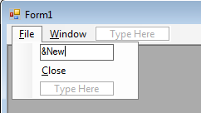
Multi-Document Interface (MDI) Applications
Drag a MenuStrip onto the form
Create a tip-level menu item with the text &File
Create sub-menu items &New and &Close
Create a top-level menu item called &Window
Notes:
From the Toolbox, drag a MenuStrip control to the form. Create a top-level menu item with the Text property set to &File with submenu items called &New and &Close. Also create a top-level menu item called &Window.
The ampersands (&) in the menu item names will specify the hotkey that will activate the menu item when the Alt key is held down.

Slide 6
Multi-Document Interface (MDI) Applications
In Solution Explorer, right-click the project -> Add -> Add New Item
Select Windows Form
Name the form Form2
Drag a RichTextBox control onto the form
Set the Anchor property to Top, Left
Set the Dock property to Fill
Notes:
MDI child forms are an essential element of Multiple-Document Interface (MDI) Applications, as these forms are the centre of user interaction.
These steps will create an MDI child form that displays a RichTextBox control, similar to most word-processing applications. Substituting the System.Windows.Forms control with other controls, such as the DataGridView control, or a mixture of controls enables you to create MDI child windows (and, by extension, MDI applications) with diverse possibilities.
In Solution Explorer, right-click the project, point to Add, and then select Add New Item.
In the Add New Item dialog box, select Windows Form (in Visual Basic or in Visual C#) or Windows Forms Application (.NET) (in Visual C++) from the Templates pane. In the Name box, name the form Form2. Click the Open button to add the form to the project.
This form will be the template for your MDI child forms.
The Windows Forms Designer opens, displaying Form2.
From the Toolbox, drag a RichTextBox control to the form.
In the Properties window, set the Anchor property to Top, Left and the Dock property to Fill.

Slide 7
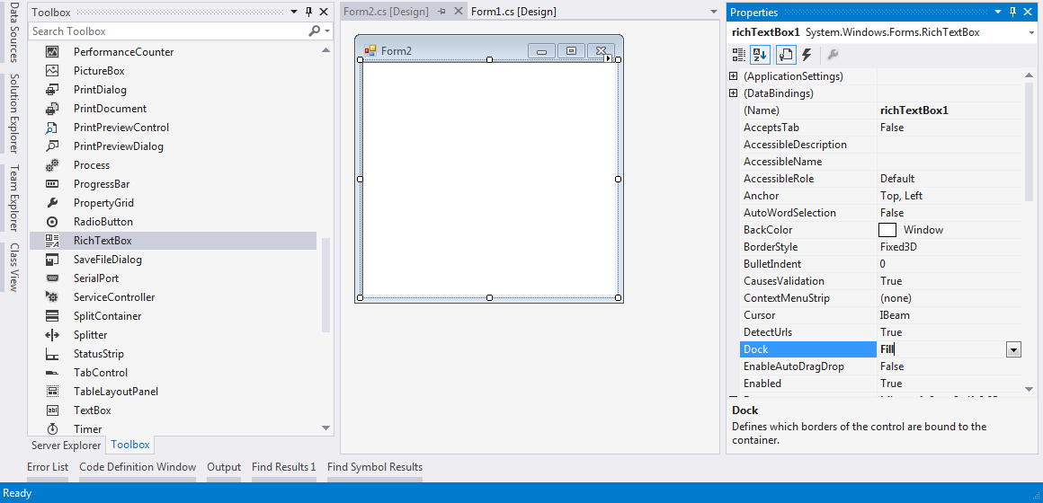

Slide 8
Multi-Document Interface (MDI) Applications
Double-click on the New menu item
Insert this code in the event handler
private void NewMenuItem_Click(object sender, EventArgs e)
{
Form2 newMDIChild = new Form2();
// Set the Parent Form of the Child window.
newMDIChild.MdiParent = this;
// Display the new form.
newMDIChild.Show();
}
Notes:
Double click the New menu item to create a Click event handler for it.
Insert this code to create a new MDI child form when the user clicks the New menu item.
(You may want to change the Name of the menu item before doing this, so you don’t get some weird default function name)

Slide 9
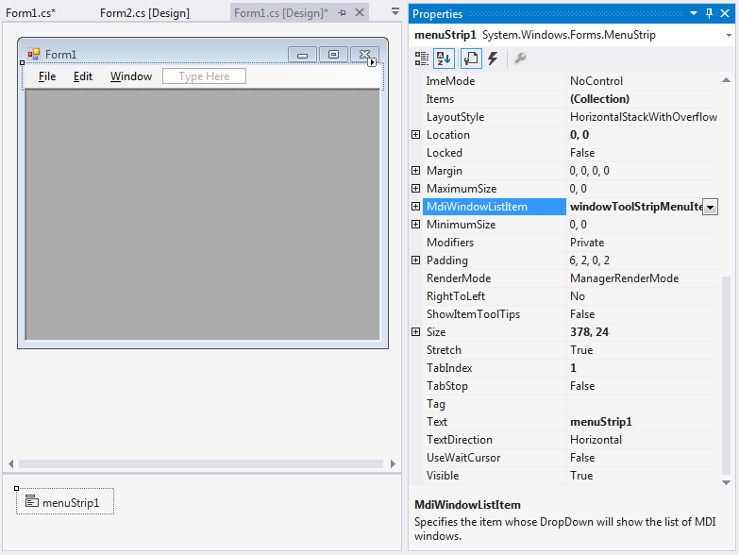
Multi-Document Interface (MDI) Applications
On Form1, select the MenuStrip
Set the MdiWindowListenItem property to windowToolStripMenuItem
The Window menu will now maintain a list of open MDI children
Notes:
In the Forms Designer, open Form 1 and ensure that the MenuStrip control is selected.
Set the MdiWindowListItem property to the Window ToolStripMenuItem.
This will enable the Window menu to maintain a list of open MDI child windows with a check mark next to the active child window.

Slide 10
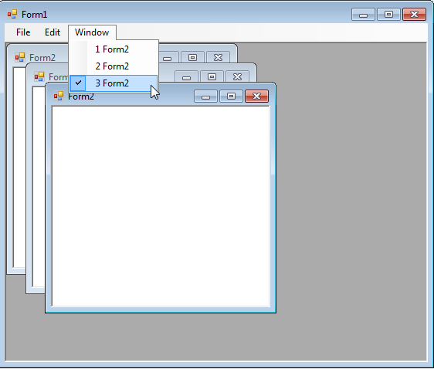

Slide 11
Cut and Paste
With an MDI application, we need to determine the active MDI child
We can use the ActiveMdiChild property
If the form has several controls, we must also specify which control is active
We can use the ActiveControl property
Notes:
On occasion, you will want to provide a command that operates on the control that has focus on the currently active child form.
For example, suppose you want to copy selected text from the child form's text box to the Clipboard.
You would create a procedure that copies selected text to the Clipboard using the Click event of the Copy menu item on the standard Edit menu.
Because an MDI application can have many instances of the same child form, the procedure needs to know which form to use.
To specify the correct form, use the ActiveMdiChild property, which returns the child form that has the focus or that was most recently active.
When you have several controls on a form, you also need to specify which control is active. Like the ActiveMdiChild property, the ActiveControl property returns the control with the focus on the active child form.

Slide 12
Cut and Paste
private void CopyMenuItem_Click(object sender, EventArgs e)
{
// Determine the active child form.
Form activeChild = this.ActiveMdiChild;
// If there is an active child form, find the active control, which
// in this example should be a RichTextBox.
if (activeChild != null)
{
try
{
RichTextBox theBox = (RichTextBox)activeChild.ActiveControl;
if (theBox != null)
{
// Put the selected text on the Clipboard.
Clipboard.SetDataObject(theBox.SelectedText);
}
}
catch
{
MessageBox.Show("You need to select a RichTextBox.");
}
}
}
Notes:
This code will perform a copy to the clipboard. It can be called from a child form menu, a menu on the MDI form, or a toolbar button.

Slide 13
Cut and Paste
The Clipboard object exposes functions to write to, or read from the clipboard
Clipboard.SetDataObject
Clipboard.GetDataObject
Returns an IDataObject
Ensure the data is text, then retrieve the text data
Notes:
As we saw in the previous code segment, the Clipboard object exposes functions for writing text to the clipboard.
Because the clipboard can contain all sorts of data – not just text data – reading from the clipboard and sending that text data to the active child window in our MDI application is a little more complicated.
We must first call the Clipboard.GetDataObject function to get an IDataObject. This object will contain the data on the clipboard.
Once we verify that the IDataObject contains text data, we can then call the GetData function on the IDataObject to retrieve the clipboard text.

Slide 14
Cut and Paste
private void PasteMenuItem_Click(object sender, EventArgs e) {
// Determine the active child form.
Form activeChild = this.ActiveMdiChild;
// If there is an active child form, find the active control, which
// in this example should be a RichTextBox.
if (activeChild != null) {
try {
RichTextBox theBox = (RichTextBox)activeChild.ActiveControl;
if (theBox != null) {
// Create a new instance of the DataObject interface.
IDataObject data = Clipboard.GetDataObject();
// If the data is text, then set the text of the
// RichTextBox to the text in the clipboard.
if (data.GetDataPresent(DataFormats.Text)) {
theBox.SelectedText = data.GetData(DataFormats.Text).ToString();
}
}
}
catch {
MessageBox.Show("You need to select a RichTextBox.");
}
}
}
Notes:
This example assumes the MDI child windows contain a RichTextBox control.

Slide 15
Drag and Drop Operations
In Form2 replace the RichTextBox with a standard TextBox
RichTextBox offers drag-and-drop via the EnableAutoDragDrop property
For the TextBox, set AllowDrop property to True
Set Multiline property to True
Add the MouseDown, DragDrop and DragEnter event handlers
Notes:
The RichTextBox contains a property called EnableAutoDragDrop. Setting this property to True will … enable drag and drop automatically.
However, many of the controls don’t offer drag and drop functionality out of the box.
Replace the RichTextBox with a normal TextBox, which doesn’t offer drag and drop functionality by default.
Set the AllowDrop property to True. You will also want to make the textbox multiline so that its functionality is similar to the rich textbox. Set the multiline property to true.
Add the MouseDown, DragDrop and DragEnter event handlers

Slide 16
Drag Operations
private void textBox1_MouseDown(object sender, MouseEventArgs e)
{
textBox1.DoDragDrop(textBox1.Text, DragDropEffects.Copy | DragDropEffects.Move);
}
textBox1.SelectedText will get the currently selected text in the textbox
In this instance that won’t work well because dragging to select will instead initiate the drag-and-drop operation
Notes:
All drag-and-drop operations begin with dragging.
The functionality to enable data to be collected when dragging begins is implemented in the DoDragDrop method.
In the code segment on this slide, the MouseDown event is used to start the drag operation because it is the most intuitive (most drag-and-drop actions begin with the mouse button being depressed). However, remember that any event could be used to initiate a drag-and-drop procedure.
This specific sample will copy the entire textbox text to the clipboard when the drag operation starts.
You could use textBox1.SelectedText to get the currently selected text, but in this instance that wouldn’t work because the dragging that the user might do to select text will actually begin the drag and drop operation.
To get this working you would have to do something like check if there is a selection before calling DoDragDrop. If there is no current selection, then select the text instead.

Slide 17
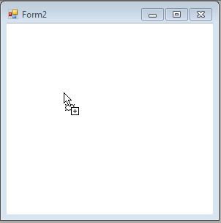
Drop Operations
private void textBox1_DragEnter(object sender, DragEventArgs e)
{
if (e.Data.GetDataPresent(DataFormats.Text))
e.Effect = DragDropEffects.Copy;
else
e.Effect = DragDropEffects.None;
}
private void textBox1_DragDrop(object sender, DragEventArgs e)
{
textBox1.Text = e.Data.GetData(DataFormats.Text).ToString();
}
Notes:
Once you have begun dragging data from a location on a Windows Form or control, you will naturally want to drop it somewhere.
The cursor will change when it crosses an area of a form or control that is correctly configured for dropping data.
Any area within a Windows Form or control can be made to accept dropped data by setting the AllowDrop property and handling the DragEnter and DragDrop events.

Slide 18
Integrating User Help
Often overlooked, but important
Windows Forms supports 2 different types:
Pointing to the Help file
HTML or HTML Help 1.x or greater
“What’s This” on individual controls
Both types can be used on the same form
Tool tips can also be used on controls
Notes:
An essential, but often overlooked, aspect of building Windows-based applications is the Help system, as this is where users turn for assistance in times of confusion.
Windows Forms support two different types of Help
The first involves pointing the user to a Help file of either HTML or HTML Help 1.x or greater format.
The second can display brief "What's This"-type Help on individual controls; this is especially useful on dialog boxes.
Both types of Help can be used on the same form.
You can also use the ToolTip component to add tool tips (pop-up messages) to individual controls.

Slide 19
Integrating User Help
Drag the HelpProvider component onto the form
Create an HTML file containing the help
Set the HelpProvider’s HelpNamespace property to this file
Set the form’s MinimizeBox and MaximizeBox properties to false, and HelpButton to true
A help icon will appear at the top-right of the form
Notes:
From the Toolbox, drag a HelpProvider component to your form.
The component will reside in the tray at the bottom of the Windows Forms Designer.
In the Properties window, set the HelpNamespace property to the .chm, .col, or .htm Help file.
For the ? icon to appear on the form, the MinimizeBox and MaximizeBox properties of the form must be set to false.

Slide 20
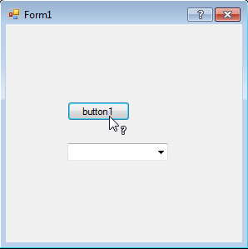
Integrating User Help
On the control you want to add help to, set the HelpKeyword property
The HelpNavigator property determines the way the HelpKeyword is passed to the help system
More information at: https://msdn.microsoft.com/en-us/library/wxdbf1a7(v=vs.110).aspx
Use the ? icon to activate the ‘What’s This?’ cursor, or press F1 for help
Notes:
Select another control you have on your form, and in the Properties window, set the HelpKeyword property.
This is the string passed through the HelpProvider component to your Help file to summon the appropriate Help topic.
In the Properties window, set the HelpNavigator property to a value of the HelpNavigator enumeration.
This determines the way in which the HelpKeyword property is passed to the Help system.
AssociateIndex - Specifies that the index for a specified topic is performed in the specified URL.
Find - Specifies that the search page of a specified URL is displayed.
Index - Specifies that the index of a specified URL is displayed.
KeywordIndex - Specifies a keyword to search for and the action to take in the specified URL.
TableOfContents - Specifies that the table of contents of the HTML 1.0 Help file is displayed.
Topic - Specifies that the topic referenced by the specified URL is displayed.
When you execute the program, you can either press F1 to launch the help page, or press the ? icon to activate the ‘What’s This’ cursor.
When this cursor is active, clicking on a control that has the HelpKeyword property set will also launch the help system.
If your help file is set up correctly, it will also jump to the appropriate place in the help file.

Slide 21
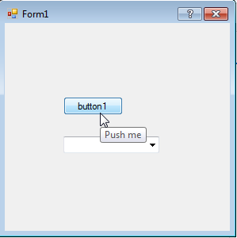
Tool Tips
Add the ToolTip control to the form
Set the ToolTip property for any control on the form
Notes:
Add a ToolTip component to the form.
Select the control that will display the ToolTip, or add it to the form.
In the Properties window, set the ToolTip on ToolTip1 value to an appropriate string of text.

Slide 22
Summary
Multi-Document Interface Applications can contain many child form windows
Cut and Paste by specifying the correct form, via the ActiveMdiChild property
Drag and Drop functionality added via the DragEnter and DragDrop events
Integrate User Help for greater usability

Slide 23
Further Reading
Microsoft, Windows Forms, MSDN
https://msdn.microsoft.com/en-us/library/dd30h2yb(v=vs.110).aspx

